Slide 1


KSU Hedge Fund
Cryptocurrency Analysis and prediction: Bitcoin (BTC-USD)

Slide 2

Project Overview
Goal
Model preparations and details
Results and conclusion

Slide 3
Project goals
Predicting Bitcoin price
Comparing real price and predicted price to see model accuracy
Using Recurrent Neural Network(RNN)

Slide 4
Model Preparations and details
Importing the data
Cleaning the data
Building RNN model
Using LSTM layers
Compiling Model Optimizer= Adam, loss= MSE
Fitting model to training and testing set

Slide 5
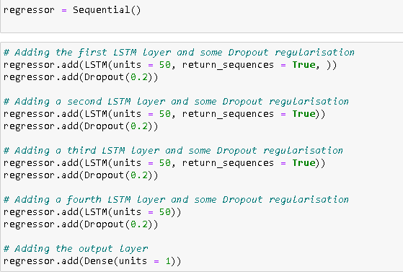
Model Preparations and details

Slide 6
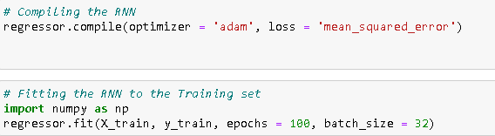
Model Preparations and details

Slide 7
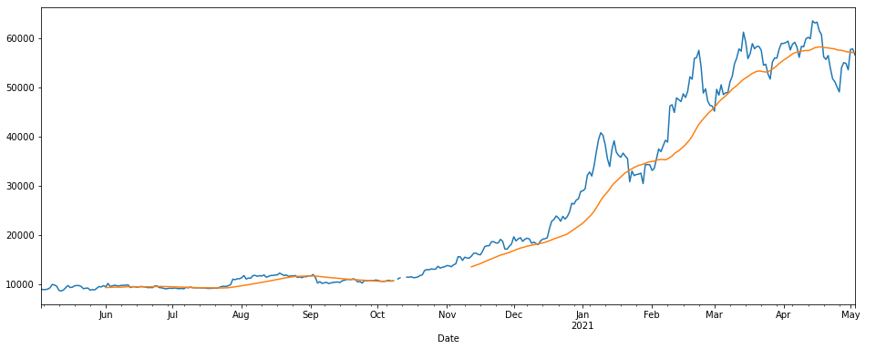
Results and conclusion

Slide 8
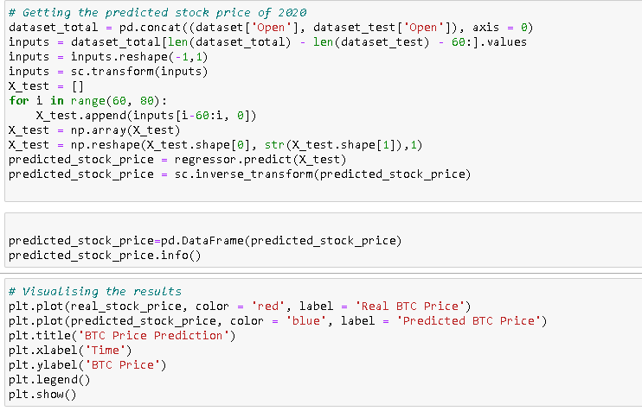
Results and conclusion

Slide 9

Thank you
Mark Christian
mchris26@kent.edu

